Slide 1
Services on IBM Cloud private catalog
Jerome Boyer boyerje@us.ibm.com

Slide 2
Objectives
After completing this lecture, you will be able to:
Understand what are the App Center applications

Slide 3
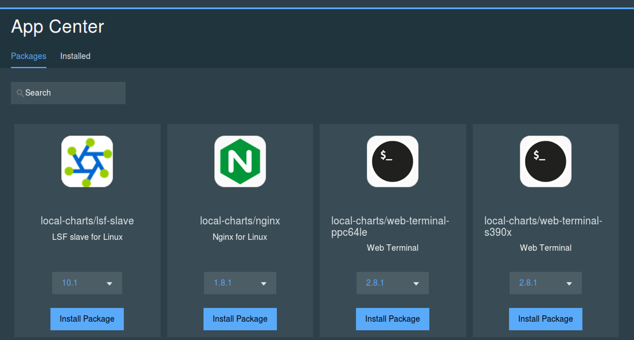

Slide 4
App Center Packages
Local-charts
Jenkins (Linux, Power)
Liberty (Linux, Power, s390)
Nginx (Linux, Power, s390)
Redis (Linux)
Web terminal (Linux , Power, s390)
Tomcat (Linux , Power, s390)
Galera (Linux)
Sockshop (linux)
Ibm-charts
Db2
postgresql
Mq
Rabbitmq
LSF (Linux, Power)
Microservice builder

Slide 5
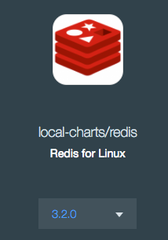
Redis 3.2.0
Open source for in-memory data structure store, used as a database, cache and message broker
Key-value store
Time based value expiration
List, Set, Sorted Set,hashes…
A lot of SDKs supported
Can be used to cache data for a nodejs app
http://redis.io
var redis = require('redis'); // create a new redis client and connect to our local redis instance var client = redis.createClient();
// store the key-value pair (username:totalStars) in our cache with an expiry of 1 minute (60s) client.setex(username, 60, totalStars);

Slide 6
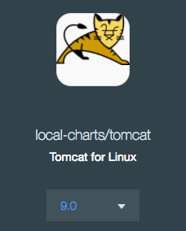
Tomcat 9.0
Servlet 4.0 and JavaServer Pages 2.3
Lightweight servlet container for Java web app
Good fit for spring boot app
https://tomcat.apache.org/tomcat-9.0-doc/index.html

Slide 7
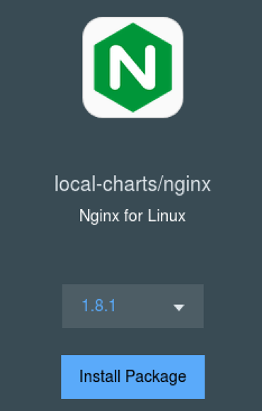
Nginx
A powerful web server: HTTP, reverse proxy, load balancer, …
Speed:
single threaded and events based
Offload SSL processing with nginx reverse proxy
Caching capability
Load balancing
Scalable concurrent connection handling
Hot deployment for upgrade
Easy to configure via modules
Easy to install … even more with charts

Slide 8
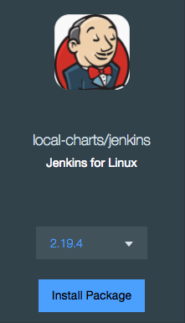
Jenkins
simple CI server or turned into the continuous delivery hub for any project
Integrate with any CI/CD toolchain via plugins
Distributes
http://redis.io
May be a challenge to run critical app and jenkins on same host … Dev cluster?

Slide 9
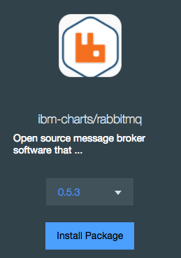
Rabbitmq
Lightweight message broker for cloud, distributed and federated configurations
point to point, request/reply and pub-sub
Reliable delivery, security
HA
A lot of protocol supported
Rich client SDK language set
for distributing a message to multiple recipients for consumption
for balancing loads between workers under high load (20k+/sec)
http://www.rabbitmq.com

Slide 10
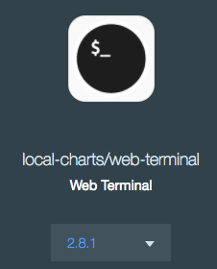
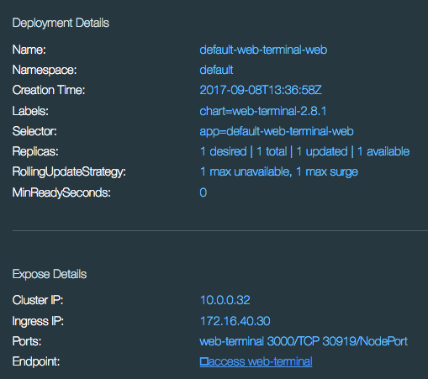
Web Terminal
Offers Linux Terminal within a web browser.
You are web-terminal user
Connected to one pod

Slide 11
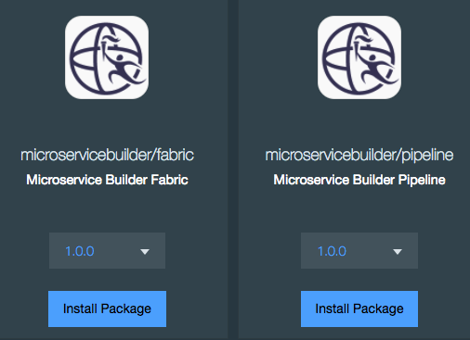
Microservice Builder
UI + CLI to create web app, microservice,…
Generate source
Build docker image transparently
Jenkins
Kubernetes configuration
includes configuration, development, deployment, capacity planning and monitoring to ensure a smooth microservices lifecycle
Pipeline to manage CI/CD
VERY COOL!!!
https://www.ibm.com/us-en/marketplace/microservice-builder
https://developer.ibm.com/microservice-builder

Slide 12
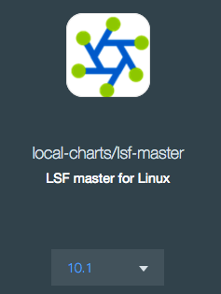
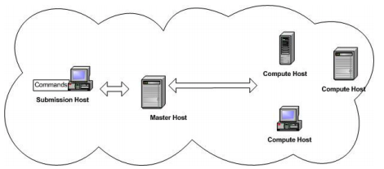
LSF - Load Sharing Facility
Distributes work across existing heterogeneous IT resources to create a shared, scalable, and fault-tolerant infrastructure
Used to schedule jobs to run on a cluster of hosts.
Machine Learning searches
Electric Design Automation computation
..
https://www.ibm.com/support/knowledgecenter/en/SSWRJV_10.1.0

